Slide 1

RNS Institute of Technology
(AICTE Approved, VTU Affiliated and NAAC ‘A’ Accredited)
Department of Information Science and Engineering
(Accredited by NBA for the Academic Years 2018-19, 2019-20,2020-21, 2021-22 and 2021-22)
Data structures Laboratory-18CSL38
TELEPHONE DIRECTORY
Carried out by:
Saurav Kumar (1RN20IS140)
Seema Sadiya R(1RN20IS141)
Sheikh Saifulla (1RN20IS142)
Sharanya RP (1RN20IS143)
Sharath Kumar BS (1RN20IS144)
Staff in Charge: Mrs. Sunitha K
Designation: Assistant Professor

Slide 2
Sl No. | CONTENTS
1. | Objectives
2. | Introduction
3. | Data Structure
4. | System Requirements
5. | Salient Features
6. | Algorithm
7. | Flowchart
8. | Conclusion
9. | Further Enhancements
10. | Result

Slide 3
OBJECTIVES OF THE PROJECT
To record and update details.
It will simplify the task and save more paperwork.
Fast speed data processing.
Can be easily accessed by anyone.
To locate details based on the name.

Slide 4
INTRODUCTION
What is Telephone Directory?
Often known as a phone book.
It is an account-based system.
Used for viewing, adding, modifying, searching and deleting phone records based on names and phone numbers.

Slide 5
INTRODUCTION
Why Telephone Directory is important?
It helps user to manage contacts based on the names using telephone directory.
Technical assignment to store contacts.
Which data structures are used ?
Files and structures
They are easy to code and understand.

Slide 6
WHY ARE WE USING THESE DATA STRUCTURES?
->Structures
•Structures can store data of any type, which is practical and more useful.
•We use structure to group several related things in one place.
•The structure puts the information in one place, with easy access.

Slide 7
WHY ARE WE USING THESE DATA STRUCTURES?
->Files
•A file represents a sequence of bytes on the disk where a group of related data is stored.
•For permanent storage of data in the external memory.
•It provides basic file operations.

Slide 8
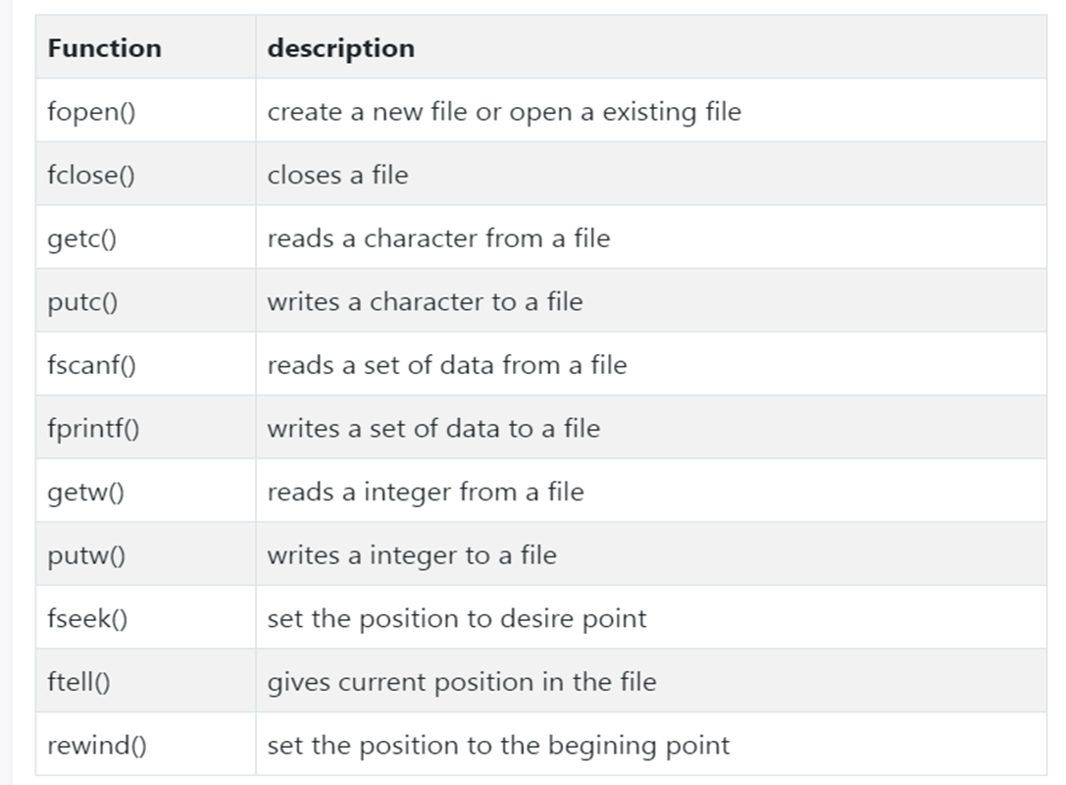
WHY ARE WE USING THESE DATA STRUCTURES?
->Following are the functions:

Slide 9
PROJECT TECHNICAL SPECIFICATION
VISUAL EDITOR CodeBlocks
PROGRAMMING LANG C
OPERATING SYSTEM Windows
PROJECT TYPE Telephone directory
INTERNET CONNECTION Yes

Slide 10
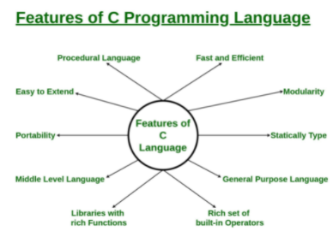
SALIENT FEATURES OF C PROGRAMMING
Modularity
Rich set of built-in Operators
Libraries with rich Functions
Middle-Level Language
Easy to Extend

Slide 11
ALGORITHM
Step 1: Start.
Step 2: Display operations on the phonebook.
Step 3: Get the user input.

Slide 12
ALGORITHM
Step 4: Generate the output based on the selected operation.
a)Adding a record
b)Displaying a record
c)Deleting a record
d)Updating a record
e)Deleting all records
f)Searching a record
Step 5: Exit

Slide 13
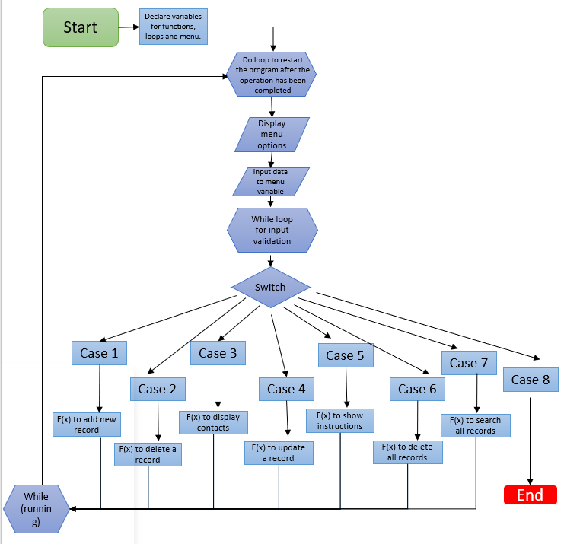
FLOWCHART

Slide 14
CONCLUSIONS
We can use it to replace our hard phone book.
This will help the user to easily manage the contacts which contains the details of the individual along with their phone numbers .
Users also will be able to update the name and phone.
numbers of an already existing record in the directory.
Appropriate error messages will be displayed.

Slide 15
FURTHER ENHANCEMENTS
The telephone directory can be further upgraded or enhanced by adding other functions to perform handy operations like:
Storing and maintaining different phonebook using cloud storage.
Including more attributes for the phone book.

Slide 16

THE FUNCTIONS INCLUDED ARE:
void error_message(char msg[]);
int total_contacts();
void showInstructions();
void update();
void delete();
void show();
void add();
int delete_all();
void search();

Slide 17
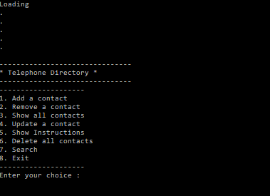
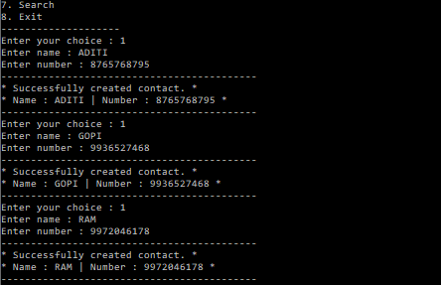
OUTPUT SCREEN
Adding contacts into directory
Beginning screen

Slide 18
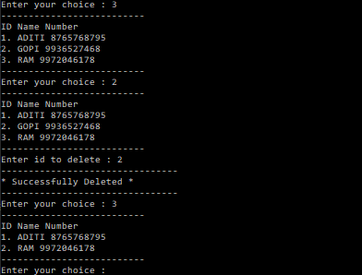
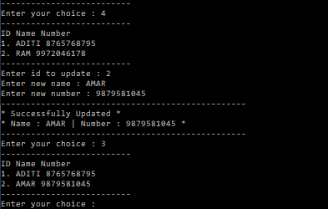
OUTPUT SCREEN
Updating the existing contacts
Display function and deleting a contact

Slide 19
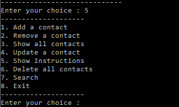
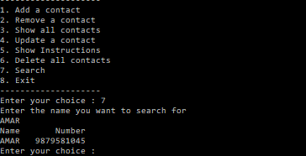
OUTPUT SCREEN
Searching for a contact
Displaying all the instructions

Slide 20
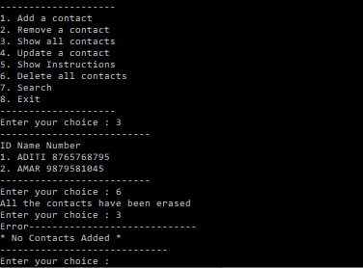
OUTPUT SCREEN
Deletion of all contacts

Slide 21


